Slide 1
Tournament Generator Start your own Tournament now!
Information System Development
Presentation group project
Alexander Büchel, Fabio Hilti, Lucy Gannon

Slide 2
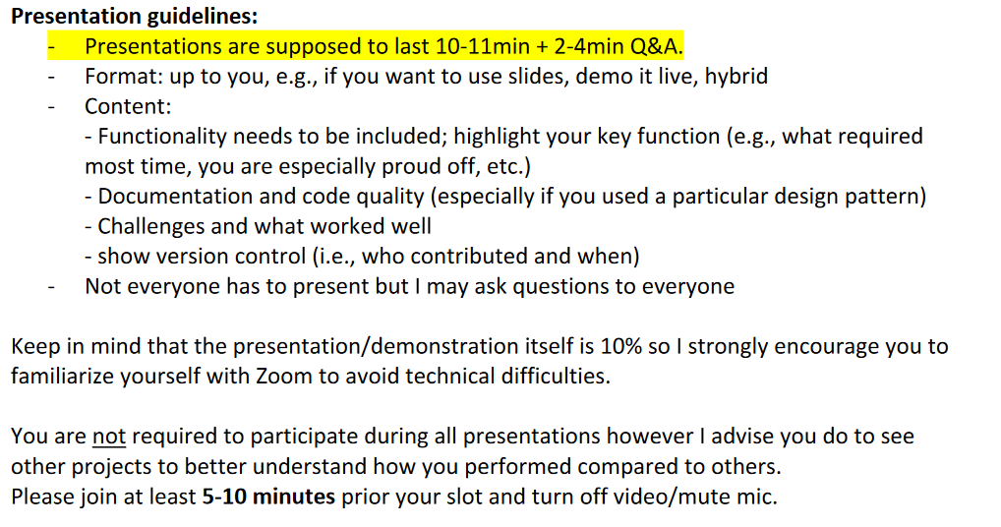
Agenda
Functionality (with live demonstration) (Fabio)
Documentation (flow chart, description, project aim) (FABIO)
Challenges (what went well, what not) (LUCY)
Code quality (screenshots from phyton) (LUCY)
What are we proud of (ALEX)
Show version control? (Screenshots or GitHub?) (ALEX)

